Slide 1
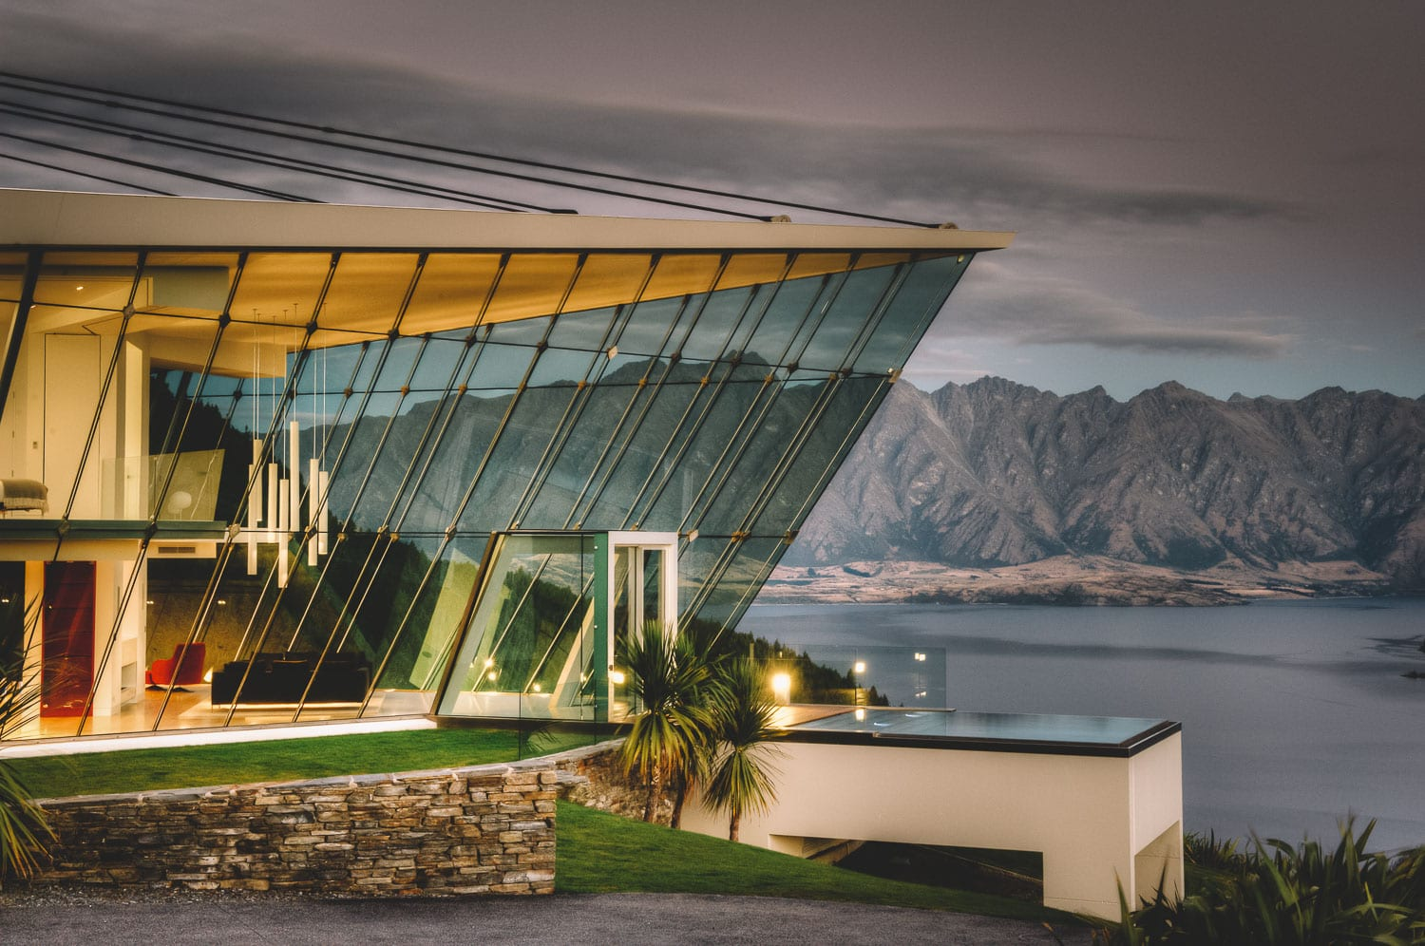
QUEENSTOWN
March 4, 2025
DIGITAL MACHINE LEARNING
Beyond
Just Hosting
GROUP

Slide 2


OUR OBJECTIVE:
Become
A Superhost?

Slide 3
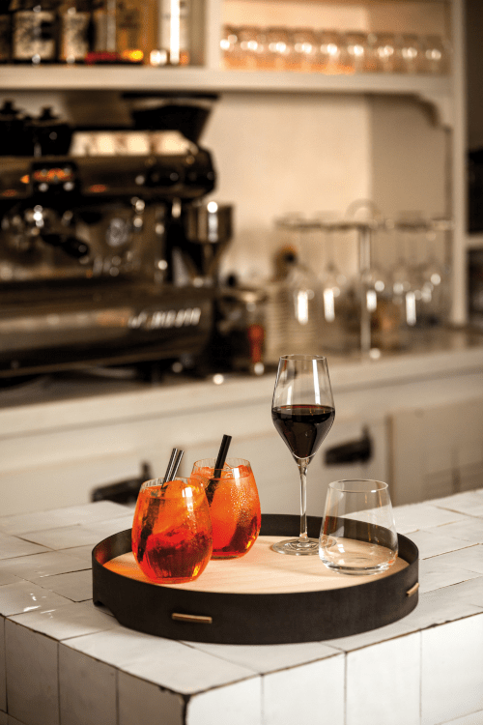
01
Introduction
02
Our Analysis-backed Approach
Agenda
03
Guests Review Analysis
04
Customer Segmentation
05
Recommendations

Slide 4
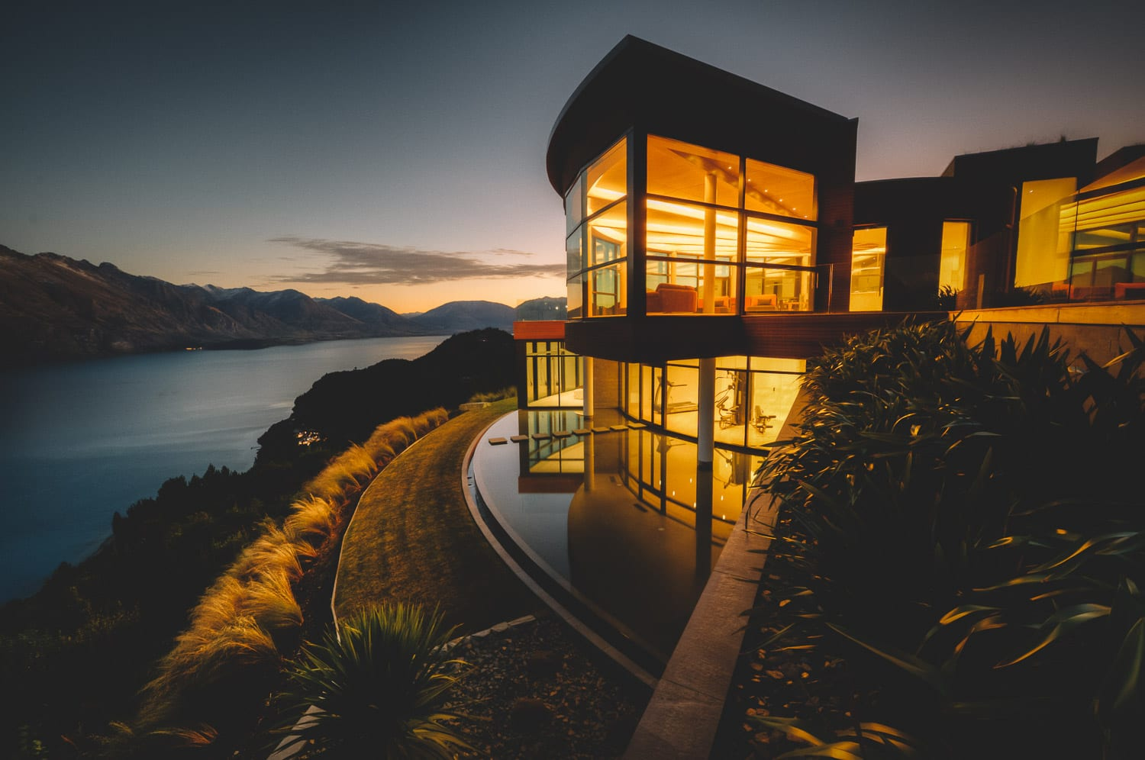
Data Overview

Slide 5
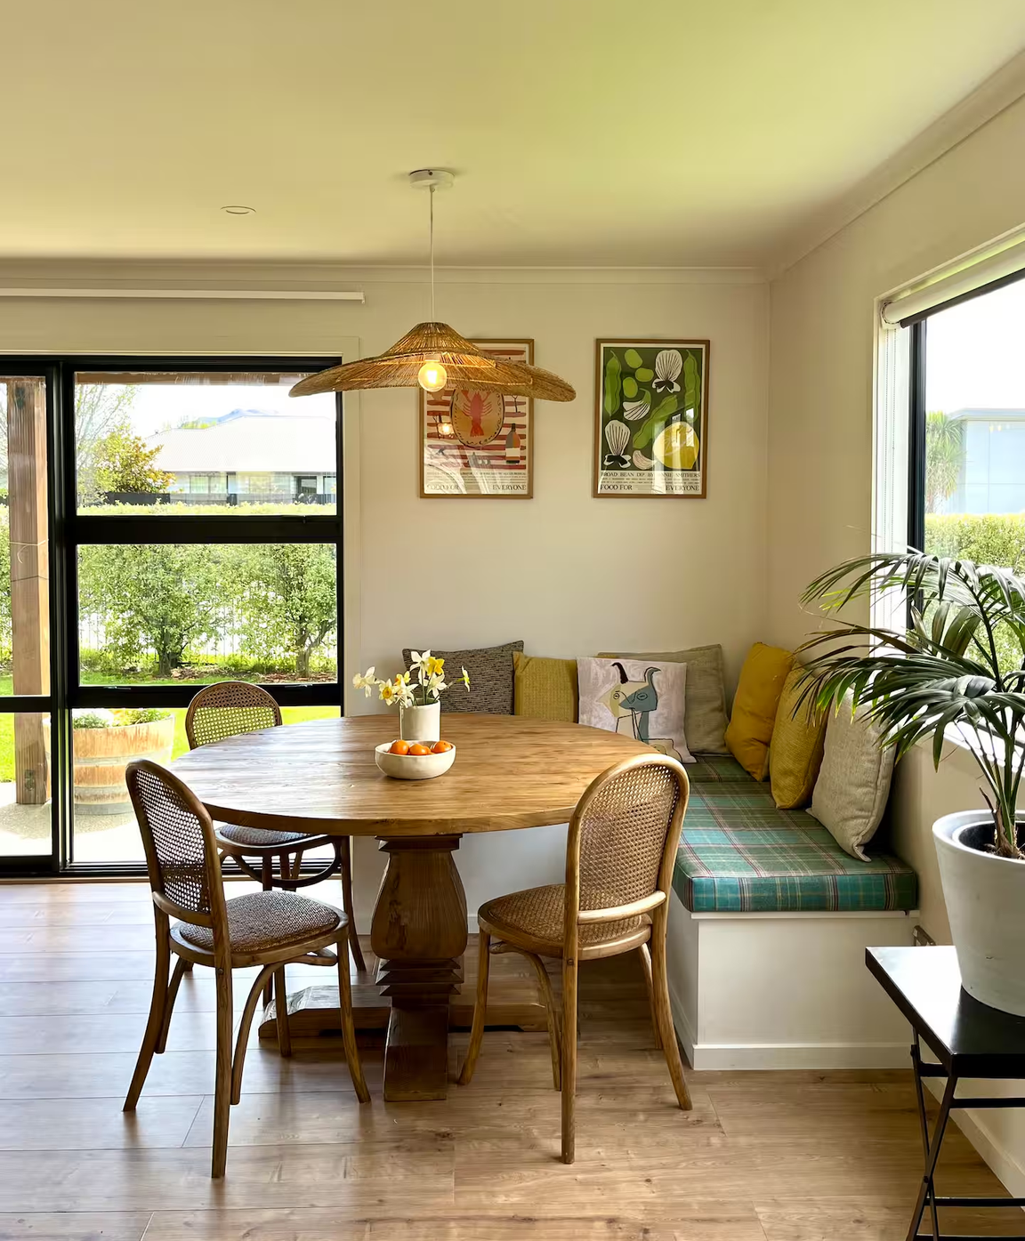
New Zealand
50263
Listings
Notes:
Listing Number : 50263
Super Host Count: 22349
Superhose Percentage : 44.46

Slide 6
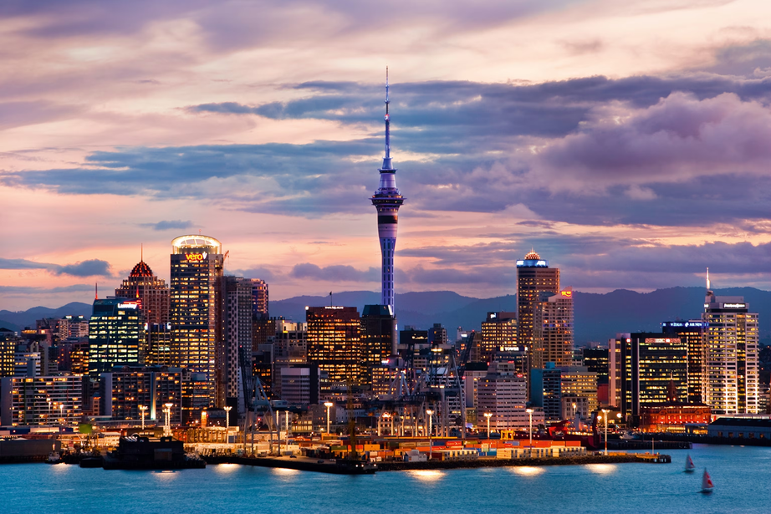
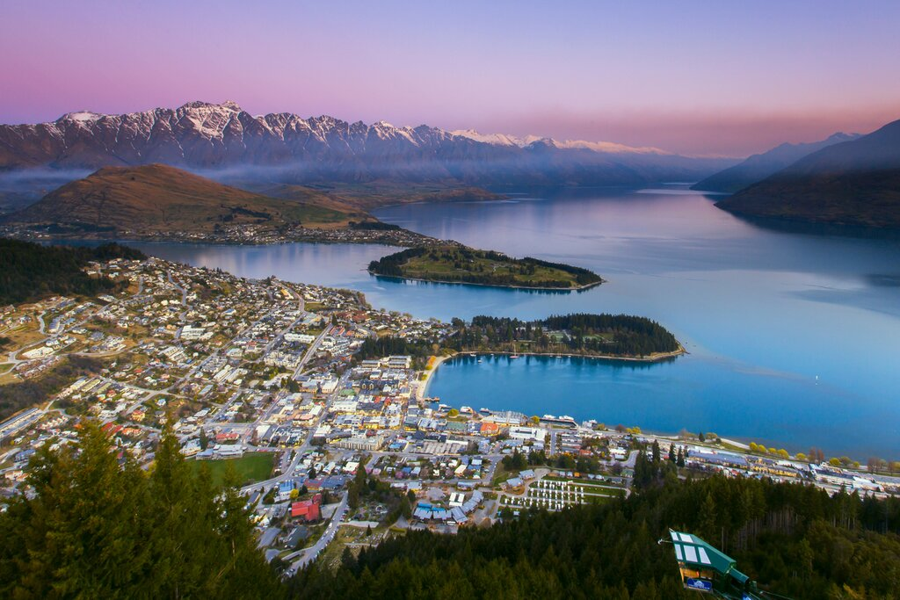
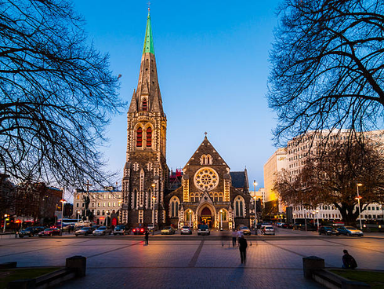
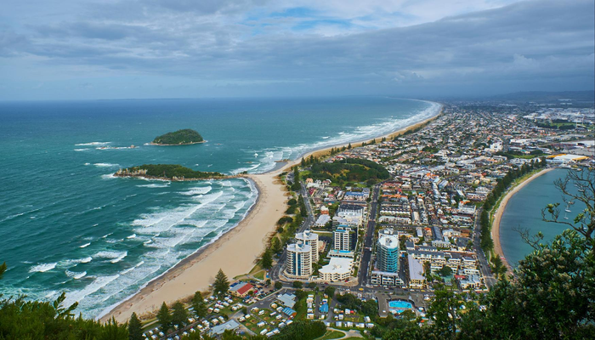
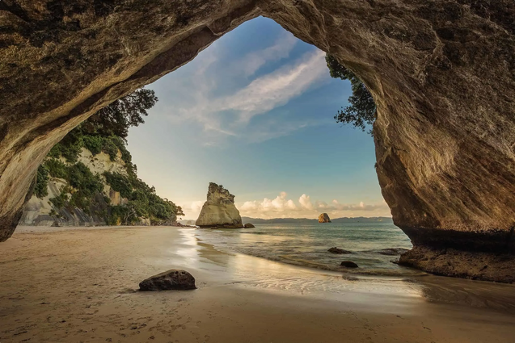
Top 5 Regions
with the highest number of listings
Auckland
Queenstown
Christchurch
Tauranga
Coromandel

Slide 7
We chose Queenstown...
it has the highest proportion of superhost
 | Region Name | Total Listings | SuperHost Count | Super Host Ratio
1 | Auckland | 9901 | 3395 | 34.4%
2 | Queenstown | 5725 | 3336 | 58.3%
3 | Christchurch | 3072 | 1619 | 52.7%
4 | Tauranga | 2404 | 849 | 35.32%
5 | Coromandel | 1989 | 698 | 35.09%
Data Collection Date: Jan 2025
Notes:
competitive market in Queenstown
business point of view
think as a host
increase visibility on the platform

Slide 8
Why Become
A Superhost?

Slide 9
1
Higher Visibility & More Bookings
Superhost badge boosts credibility
Higher ranking in Airbnb search results
2
Increased Earnings Potential
Benefits of
being a
Super Host
More bookings lead to higher revenue
Higher nightly rates due to trust and guest preference
Stand out amongst the competitors
3
Exclusive Rewards & Perks
Priority customer support from Airbnb
Travel coupons, early access to new features, and promotional incentives
Notes:
Slide Summary: Benefits of Being a Superhost
1️⃣ Higher Visibility & More Bookings
✔ Superhost badge boosts credibility, attracting more potential guests.
✔ Higher ranking in Airbnb search results.
2️⃣ Increased Earnings Potential
✔ More bookings lead to higher revenue.
✔ Higher nightly rates due to trust and guest preference.
3️⃣ Exclusive Rewards & Perks
✔ Priority customer support from Airbnb.
✔ Travel coupons, early access to new features, and promotional incentives.

Slide 10
How to Become
A Superhost?

Slide 11
1
Reservation Number
over 10 reservations
3 reservations with total 100 nights +
2
Response Rate
Super Host Criteria
Maintain a 90% or higher rate
3
Cancellation Rate
Requirement of being a superhost
Less than 1% cancellation rate
4
Reviews & Rating
Maintained a 4.8 or higher overall rating
Notes:
Requirements to be a Superhost
To be a Superhost, hosts must be the listing owner of a homes listing with an account in good standing and need to have met the following criteria:
Hosted at least 10 reservations, or 3 reservations that total at least 100 nights
Maintained a 90% or higher response rate
Maintained a less than 1% cancellation rate, with exceptions for cancellations due to Major Disruptive Events or other valid reasons
Maintained a 4.8 or higher overall rating (A review counts towards Superhost status when either both the guest and the host have submitted a review, or the 14-day window for reviews is over, whichever comes first.)
Note: The criteria is only evaluated for listings in which the host is the listing owner—any listings in which the host is a co-host won’t contribute towards their Superhost eligibility.
When Superhost status is evaluated
Every 3 months, we evaluate your performance as a host over the past 12 months for all listings on your account. (However, you don’t have to host for the entire 12 months to qualify.) Each quarterly assessment is a 7-day period beginning on:
1 January
1 April
1 July
1 October

Slide 12
Our
Analysis-backed Approach

Slide 13
How We Built the Model
Analysed
4000+
Airbnb Listings
Machine Learning Model
Logistic Regression

Slide 14
The Key Variables
Amentites Count
Booking Rate
Booking in 60 days
Instant Bookable
Host Acceptance Rate
Host Response Rate
Months Active
Total Review Score
Total Listing by Host
Total Reviews
Price per Accomondation

Slide 15
Why trust our model?
AUC - ROC Score
78.5%
Correctly distinguishing Superhosts nearly 8 out of 10 times

Slide 16
What Increases Your Superhost Chances?

Slide 17
Bookings in the next 60 days
Host Acceptance Rate
40.3%
3.9 %
39.4%
2.4%
Host Response Rate
Instant Booking
6.1 %
Higher Ratings & More Reviews
2.2%
Amenities

Slide 18
What Hurts Your Superhost Chances?

Slide 19
Total Listings By Host
0.08%
More listings can reduce quality if not managed well.
Superhost status favors consistency over quantity.
24.5%
Total Reviews
Large number of reviews alone could be unhelpful.
Quality, positive reviews are important.

Slide 20
What Guests Love
The Key to Good Reviews

Slide 21

222,240
In English
10,646
In Chinese
Queenstown attracts a mix of Western and Chinese travelers, who may have different expectations.
The difference helps hosts better cater to each audience, improving overall guest satisfaction.

Slide 22
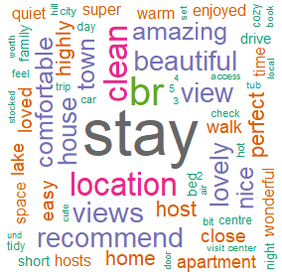
"stay," "location," "clean," "views," "recommend," "host," "beautiful," "amazing," "comfortable."
guests highly value the overall stay experience, the convenience of the location, cleanliness, and scenic views
"perfect," "lovely," "nice," "wonderful"
indicate overwhelmingly positive sentiment.
"host,""home"
guests appreciate good hospitality and the coziness of Airbnb properties.

Slide 23

"推荐" (recommend), "舒服" (comfortable) "满意" (satisfied)"房东" (host), "干净" (clean), and "方便" (convenient)
align with the positive themes seen in English reviews.
早餐 (Breakfast) 厨房 (Kitchen)
Chinese guests care about food options and having the ability to cook their own meals.
Many Chinese tourists prefer warm, familiar meals during travel, and dining options in Western countries may not always match their preferences.
风景 (Scenery) 阳台 (Balcony)
Chinese guests highly value properties with great views
This aligns with cultural preferences—Chinese travelers often prioritize locations for sightseeing and taking photos during their trips.

Slide 24
What Customers Care about
Cleaning Standards
Noise Issues
Maintain high cleanliness standards—it’s a top priority for all guests.
Address noise issues, especially in busy areas, to improve comfort.
Emphasize
Chinese Visitors
Emphasize stunning views and location advantages in listings.
Encourage Chinese guests to leave recommendations to attract more visitors.

Slide 25
Customer
Segmentation
Notes:
In order to meet customer satisfaction, we decide to understand specific customer profiles to provide most suitable services
Every airbnb is different, and there are different kind of customers looking for different things while looking for airbnb..
best way to satisfy customers, is to know your cutsomers.
for this purpose, we divide the customers into 3 segments based on their characteristics and why they select superhosts in quenstown

Slide 26
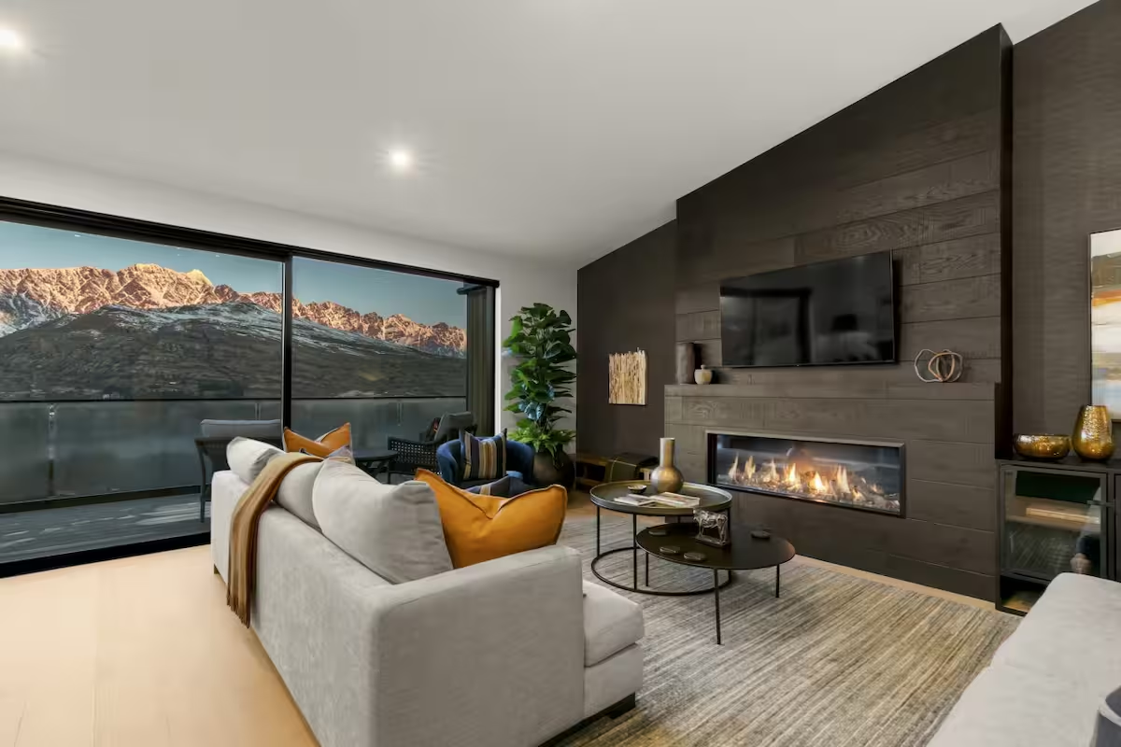
Key Variables
Most different Variables
No of Guests
Price
Superhost status
Region
Reviews
Overall ratings
Room Type
Availability in the next 2 months
Notes:
- have taken into account all the variables we considered for clustering (Room type, price, reviews etc)
- since Avg price & Avg Accommodates (Avg No of Guests) were the differentiating factors when we ran our clustering, i created a separate graph to show the differences.
See last slide for reference - after References slide

Slide 27


Customer Segmentation
Average Price VS. Average Number of Guests
10
8
Average Number of Guests
Average Price (NZD)
6
Average Number of Guests
Average Price
4
2
Notes:
- have taken into account all the variables we considered for clustering (Room type, price, reviews etc)
- since Avg price & Avg Accommodates (Avg No of Guests) were the differentiating factors when we ran our clustering, i created a separate graph to show the differences.
See last slide for reference - after References slide
fix this tmr

Slide 28



What Do These Personas Look For?
CLUSTER 1
CLUSTER 2
CLUSTER 3
Couples / Duos
Solo Traveller
Families
Notes:
Budget-conscious & independent.
Prefers affordable stays with good reviews.
Looking for privacy and a comfortable stay.
Family with kids looking for high-end, spacious stays.

Slide 29

The Budget-Conscious Solo Traveler
Age: 25 years old
Occupation: Travel Vlogger
Location: Frequently traveling
Income Range: $30,000 - $50,000
Alex Parker
Travel Behavior
Relies on guest reviews before booking
Seeks easy, flexible check-in & values Instant Booking
Prefers proximity to attractions & public transport
Preferences
Budget-friendly, well-rated accommodations
Strong WiFi & workspace for vlogging & editing
Solo-friendly amenities (compact yet functional spaces)
Budget Range: $150 - $250

Slide 30

The Privacy-Seeking Getaway Couple
Age: 31 & 32
Occupation: Software Engineer & Teacher
Location: Wellington, New Zealand
Income: $160,000
Mia & Jake
Travel Behavior
Enjoys romantic & peaceful retreats, away from crowds
Prefers well-designed, cozy accommodations over budgeted
Values unique & intimate experiences (scenic views, etc.)
Preferences
Quiet, cozy, and stylish spaces for relaxation
Private outdoor spaces (balcony, patio, or garden)
Well-equipped kitchen for homemade meals
Budget Range: $300 - $410

Slide 31
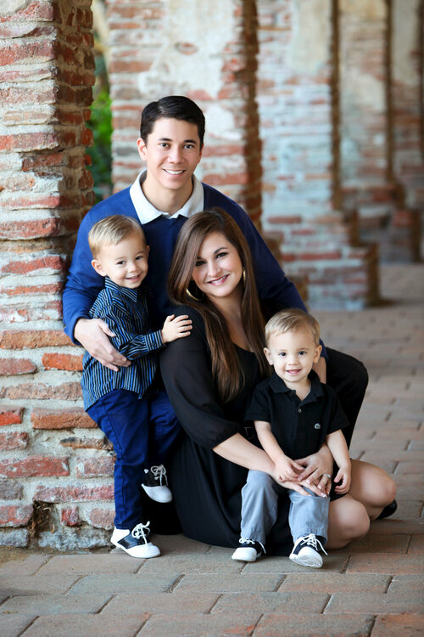
The High-End Family Travelers
Age: 40 & 38, Kids: 2 & 3 years old
Occupation: Cardiologist & GP
Location: Christchurch, New Zealand
Income: $200,000
The Jackson Family
Travel Behavior
Prefers spacious, high-end accommodations
Prioritizes safety & child-friendly amenities
Values comfort, cleanliness, and well-equipped kitchens
Preferences
Safe and secure environment with minimal risks
Family-friendly amenities (high chair, baby crib, play area)
Nearby attractions for family-friendly entertainment
Budget Range: $430 - $1,300

Slide 32
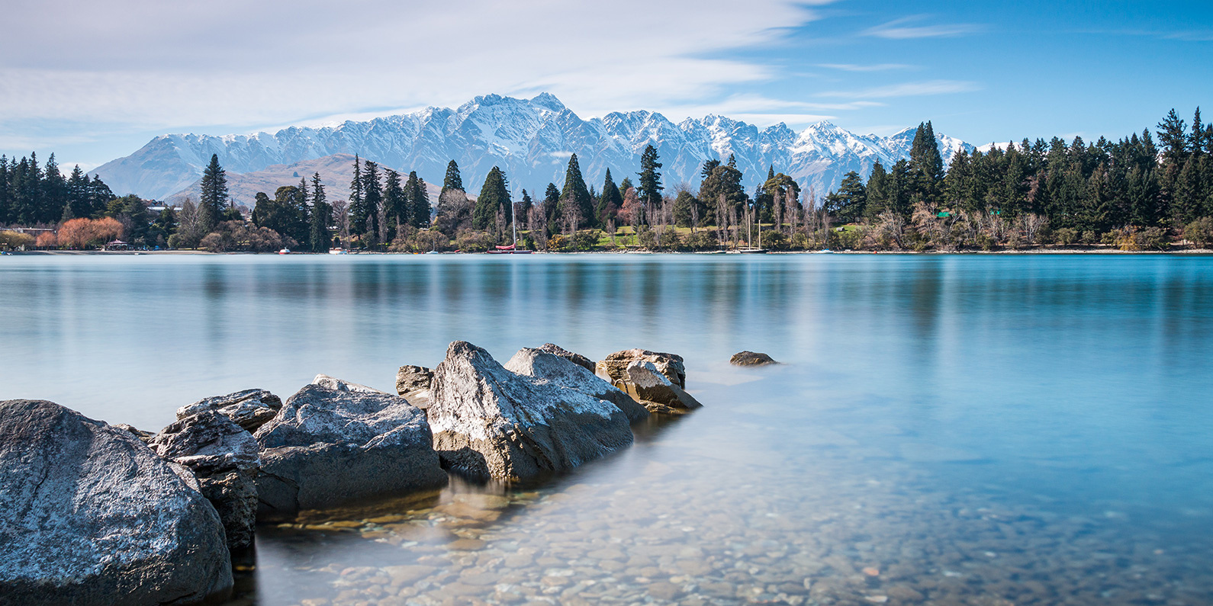
Recommendations
Notes:
In order to meet customer satisfaction, we decide to understand specific customer profiles to provide most suitable services
Every airbnb is different, and there are different kind of customers looking for different things while looking for airbnb..
best way to satisfy customers, is to know your cutsomers.
for this purpose, we divide the customers into 3 segments based on their characteristics and why they select superhosts in quenstown

Slide 33
Enable Instant Booking
Higher chance to be superhost
Increased visibility on the platform
Notes:
✅ Why? Hosts who enable Instant Booking are significantly more likely to become Superhosts.
📌 Actionable Step:
Turn on Instant Booking to increase visibility and improve guest experience.
Airbnb prioritizes Instant Bookable listings in search results, boosting your booking rate.

Slide 34
Actional Steps
Amazing Views
Mention if the listing has a great view
in the title and description
Highlight Beautiful Views & Location
High Quality Photos
showcase the surroundsings
Top 10 most frequently positive words
“Views,” “location,” and “beautiful”
Provide Welcome guide
Highlight nearby attractions restaurants and scenic spots.
Notes:
In order to meet customer satisfaction, we decide to understand specific customer profiles to provide most suitable services
Every airbnb is different, and there are different kind of customers looking for different things while looking for airbnb..
best way to satisfy customers, is to know your cutsomers.
for this purpose, we divide the customers into 3 segments based on their characteristics and why they select superhosts in quenstown

Slide 35
Actional Steps
Be Responsive & Personal
Maximise Guest Experience & Boost Booking
Fast Response = +2.4% Higher Booking Potential increase Superhost chances
Use saved message templates to reply faster.
Send a personalised check-in message to ensure comfort.
Be welcoming—leave a handwritten note or small treat.
Deliver Outstanding Hospitality for Better Reviews
Notes:
Improve Host Interaction & Communication

Slide 36
Actional Steps
Excellent Customer Services
Ensure cleanliness & accuracy in listings. Guests highly appreciate a well-maintained space.
Maintain High Review Score
Review Encouragement
Positive revies increase credibility
Encourage positive reviews by providing exceptional experiences.
Professional Response
Respond professionally to negative reviews and continue improving.
Notes:
3. Maintain a High Review Score (+6.1%)
✅ Why? Superhosts consistently get positive reviews, which increase credibility.
📌 Actionable Steps:
• Ensure cleanliness, accuracy in listings, and excellent communication.
• Encourage reviews by providing exceptional experiences.
• Respond professionally to negative reviews and continuously improve based on feedback.
• 1. Focus on Cleanliness (#1 Most Mentioned Positive Word)
• 💡 Why? "Clean" is the most frequent positive word in reviews. Guests highly appreciate a well-maintained space.
📌 Actionable Steps:
✔ Ensure deep cleaning between stays (especially bathrooms, kitchens, and linens).

Slide 37
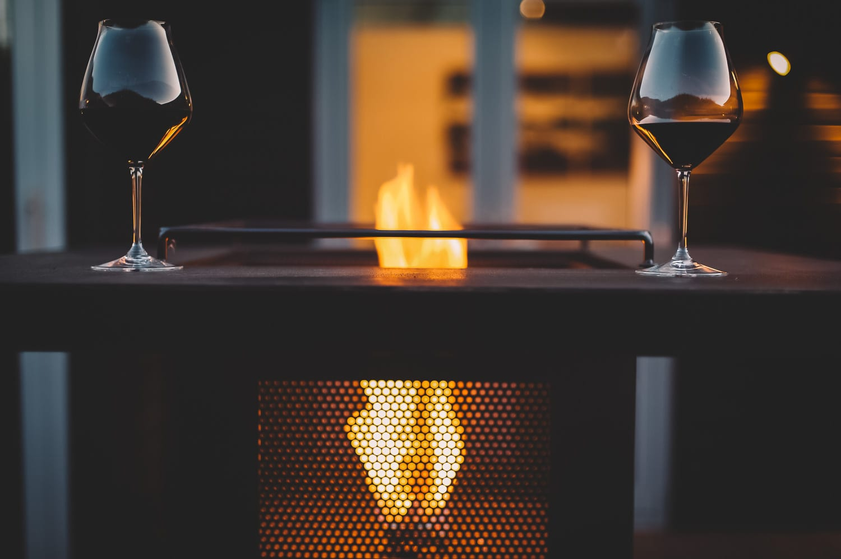
Thank you

Slide 38
References
Inside Airbnb. (n.d.). Get the data. Retrieved from https://insideairbnb.com/get-the-data/
Airbnb. (2024). City Portal. Retrieved from https://www.airbnb.co.nz/cityportal.
https://www.airbnb.co.nz/rooms/44062970?source_impression_id=p3_1740644318_P3kX2F838S8KfiCx&modal=PHOTO_TOUR_SCROLLABLE
https://www.lonelyplanet.com/articles/best-places-to-visit-in-new-zealand#:~:text=9%20of%20the%20best%20places%20to%20visit%20in,8%208.%20Napier%20Best%20for%20architecture%20...%20%E6%9B%B4%E5%A4%9A%E9%A0%85%E7%9B%AE

